Slide 1


Yummy Pizza Sales Analysis
Leveraging Data for Culinary Success

Slide 2

Project Genesis & Objectives
Purpose: Enhance sales performance through data analysis.
Scope: Analyzing 12 months of sales data.
My Role: Lead Data Analyst - from data cleaning to insights generation.

Slide 3

Project Toolbox and Prerequisites
Requirement 1: Comprehensive data cleansing and validation.
Requirement 2: In-depth sales trend analysis.
Tools Utilized: MySQL for database management, Power BI for visualization.

Slide 4

Data Preparation & Methodology
Extracted raw sales data for the year 2015.
Employed MySQL to ensure data integrity and structure.
Transformed data in Power BI for detailed analysis.

Slide 5
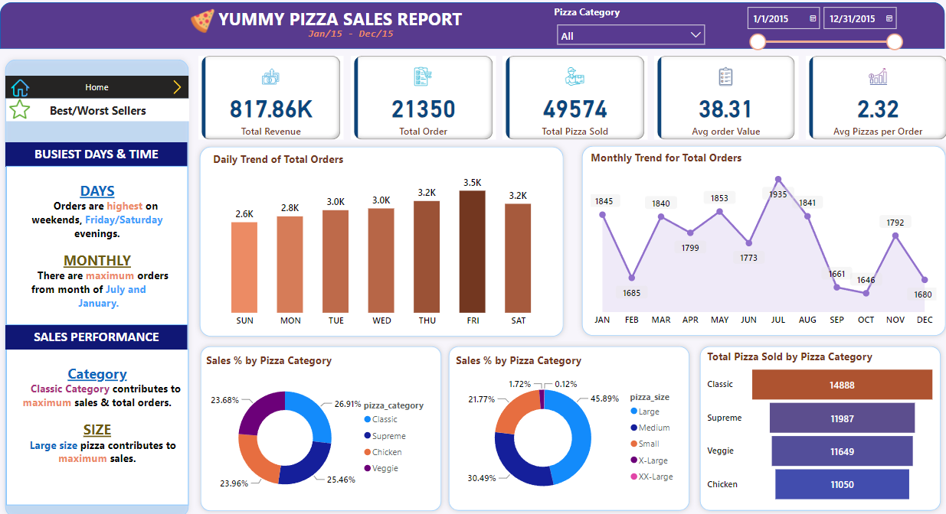
Analytical Dashboard - A Synopsis
Dashboard Goal: Instant access to sales performance metrics.
Features: Interactive filters, real-time data synthesis.

Slide 6
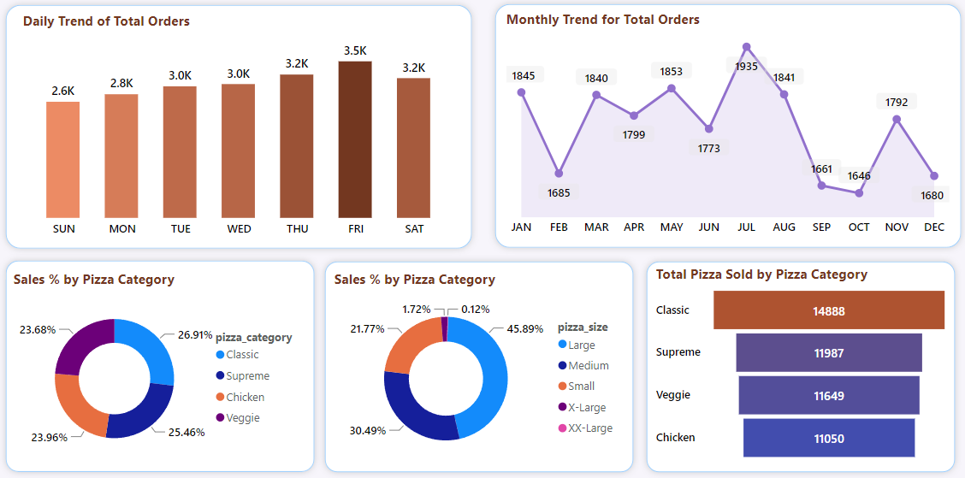

Sales Insights - The Deep Dive
Detailed analysis of pizza sales performance.
Identification of key sales drivers and patterns.

Slide 7
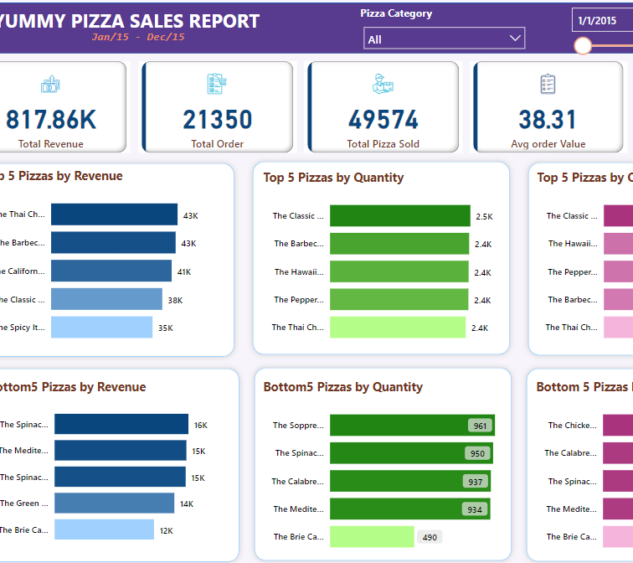
Unraveling Customer Purchase Patterns
Insights into customer buying behavior and preferences.
Seasonal trends and peak purchase times analysis.

Slide 8

Personal Contributions and Challenges Overcome
Developed SQL queries for data extraction and manipulation.
Created dynamic Power BI reports to illustrate findings.
Addressed challenge: Integrating diverse data sources.

Slide 9

Project Impact & Skill Enhancement
Delivered actionable insights leading to a targeted marketing strategy.
Gained proficiency in advanced analytical methods.
Enhanced my portfolio with a compelling case study.

Slide 10
Reflecting on the Data Journey
An exploration into data that refined Yummy Pizza’s business strategy. For detailed project insights, visit my portfolio at
https://codebasics.io/portfolio/MOHIT

Slide 11

Thank You!

